Slide 1
五夏 5SMR Lessons Learned
Rachel Haberman, Shivani Balachandar, Samantha Lin, & Michelle Lee

Slide 2
Overview
Estimate the resources required to train a customized Neural Machine Translation (NMT) engine for KO-to-EN translations
The corpus consists of social media comments drawn from Korean entertainment fan communities, covering K-pop artist performances, fandom commentary, industry news, celebrity fashion, and concert economics.
6 rounds were completed using the NMT engine Microsoft Azure.
After the rounds we did human post editing
Notes:
The purpose of this pilot project was to estimate the resources required to train a customized Neural Machine Translation (NMT) engine for KO-to-EN translations of forum-style K-pop content from Korean netizens (“internet citizens”) on Pannchoa, Instiz, and TheQoo. A total of 6 rounds were completed using the NMT engine Microsoft Azure.

Slide 3
Process
Phase 1
After client meeting we began data collection & cleaning*
Phase 3
Analysis of results
File prep
MT Training
Assessment
Delivery
*Data collection was delayed due to scheduling conflicts and process we used to collect data..
Phase 2
Phase 4
6 rounds of training with PEMT and Human Evaluation
Updated proposal +
Deliverables for client

Slide 4
Timeline
-Kickoff meeting
-Set up Microsoft Translator Hub
-Training
-PEMT
-Human Evaluation
Presentation
March 4
Mar 4-28
Mar 29-Apr 12
Apr 12-14
Apr 15
-Data collection
-Cleaning
-Alignment
-Results Analysis
-Final Time/Cost Calculations
Notes:
Updated timeline - due to delays we agreed to push back deadline w client

Slide 5
What went well
Data Quality
K-pop related, slangy comments with quality EN human translations were easy to find online.
(Segments were already short; less cleaning required)

Slide 6




(Instiz)
Notes:
For our data, we found previously human translated data from these forums (theqoo and instiz) on a website called pannchoa and then went back to the source to find the original korean comments. (next slide)

Slide 7
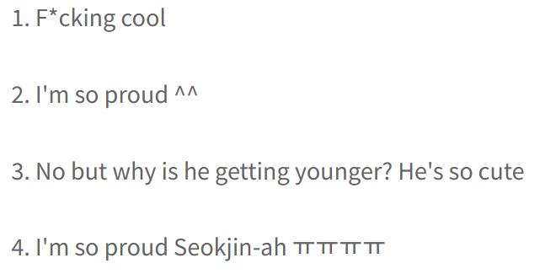
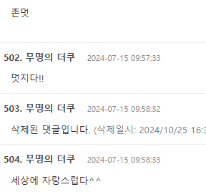
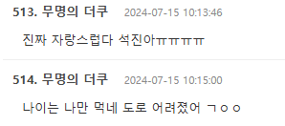
(Instiz)
Notes:
This is an example of the translation on pannchoa vs the original comment thread in theqoo. (we talk abt this next part later so we dont have to say it here necessarily) As you can see it was a very tedious collection process due to having to parse through the side and find the matching comments, with many deleted comments as well. You can see the frequent use of slang/abbreviations, and emoticons which we needed to keep in mind for our glossary and pemt process.

Slide 8
What went well
Evaluation
Rhythm
The bleu scores went up each round as predicted which let us know we were on the right track;
Our post-editing and scoring process sped up as quality improved/we added to TM and TB

Slide 9
BLEU Score
Total BLEU score increase:
1.7
Round | BLEU Score
1 | 15.1
2 | 15.4
3 | 16.1
4 | 15.9
5 | 16.7
6 | 16.8
Notes:
Our bleu score was fairly low from the beginning due to the difficulty of the translation task (so much slang/niche k-pop fandom terms/super informal register etc) but as we post edited we did see a slight improvement across our rounds. Post editing effort was super heavy at first but as we built our tm/glossary it sped up a little.

Slide 10
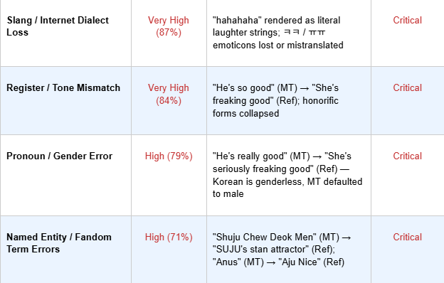
Human Evaluation
Observations:
Post-editing effort is extremely high → often requires full retranslation
Main issue: domain mismatch (not trained on fan slang, emoticons, code-switching, or internet register)
Tone accuracy is low → loses humor, irony, and emotional nuance
Only partial strength: formal corporate content is moderately accurate
Major risk: named entity hallucination → can produce offensive or unusable output
Notes:
These were the most common critical error cateogires we saw throughout our rounds.

Slide 11
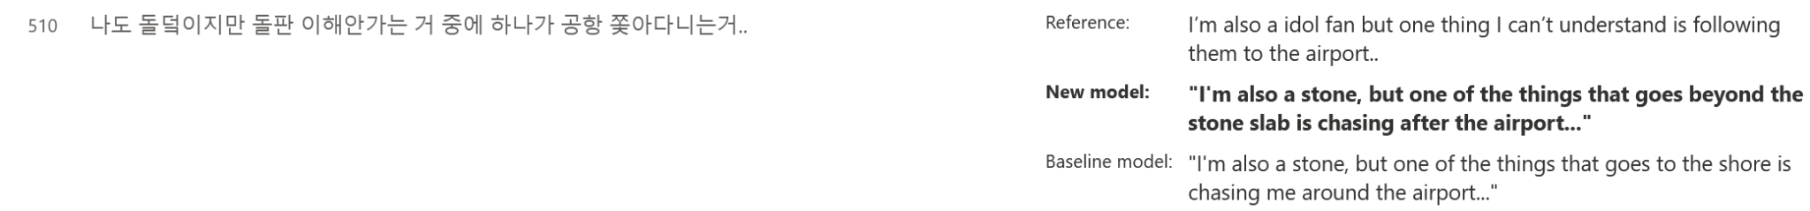
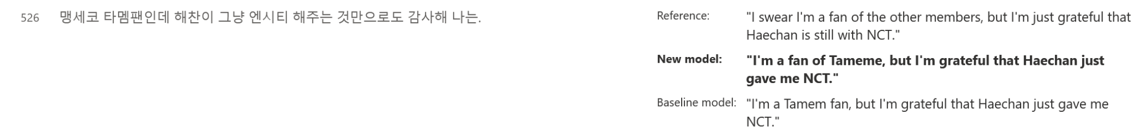
Notes:
If we want either mich/shiv can explain why some of this was mistranslated iDOL = stone etc. talk abt how we had to add kpop stan slang terms to our glossary, help maintain the informal tone/register blah blah

Slide 12
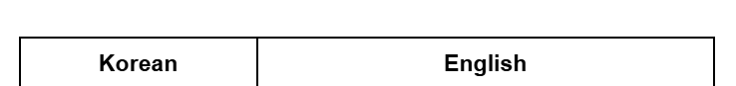
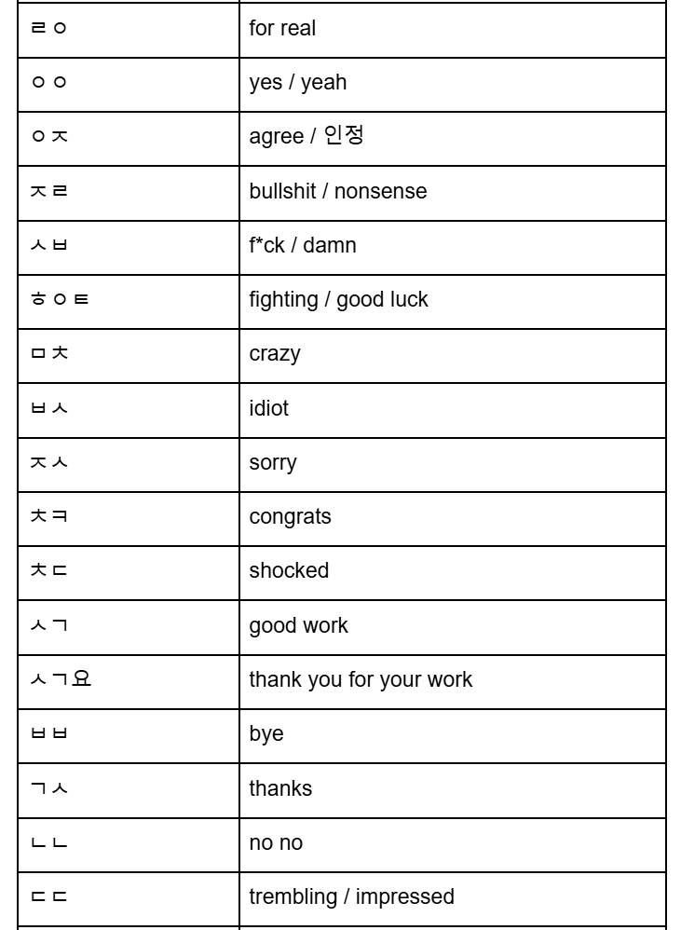
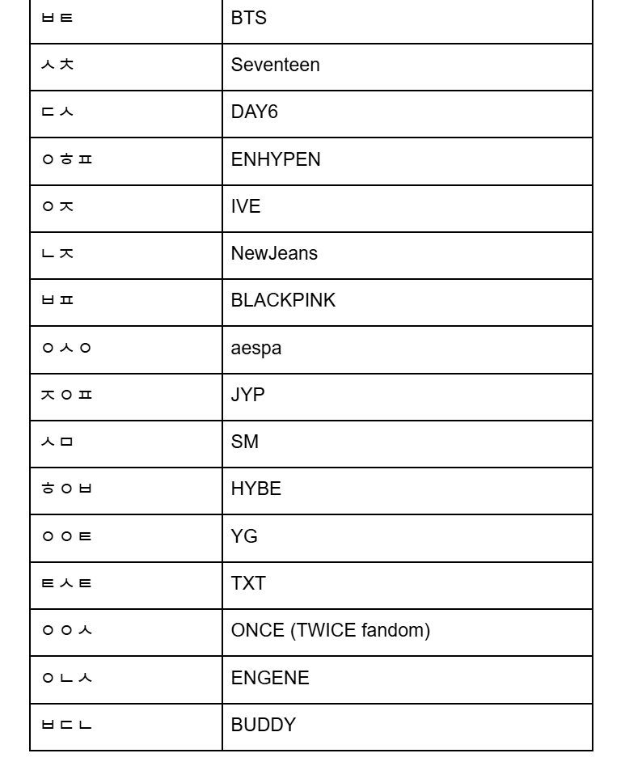

Glossary Creation
Slang and emoticons
Idol group names
*not full glossary
Notes:
WE USED ANTCONC :DDD TO FIND THE MOST COMMON WORDS AND CREATE A GLOSSARY These abbreviations were super common in our text, but appeared just as letters or were omitted in our initial training rounds. as we added all of these into our termbase/tm the post editing process significantly improved as well as our custom mt.
외키 is foreigner + cockroach (usually human translated to i-roach) (international cockroach) (how korean kpop fans refer to foreign kpop fans)

Slide 13
What went well
Learning Process
Went from zero understanding → learning → trial and error → completion & knowledge for the future
Notes:
We def learned a lot of lessons if we were to either further train this mt in the future or undertake a similar project

Slide 14
What didn’t go well
Data Collection
Inconsistency how data was collected, through copy & pasting segment per segment was, incredibly time consuming.
Notes:
Super difficult to parse through sites like theqoo as pannchoa’s human translated comments were not always in order/ hidden in threads of 1000+, or had since been deleted (especially controversial/hate comments by the OPs) … took way more time than we had anticipated

Slide 15
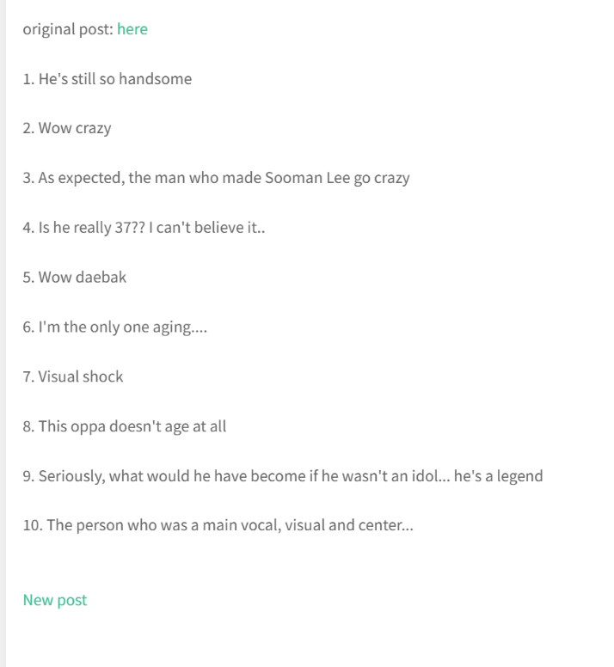
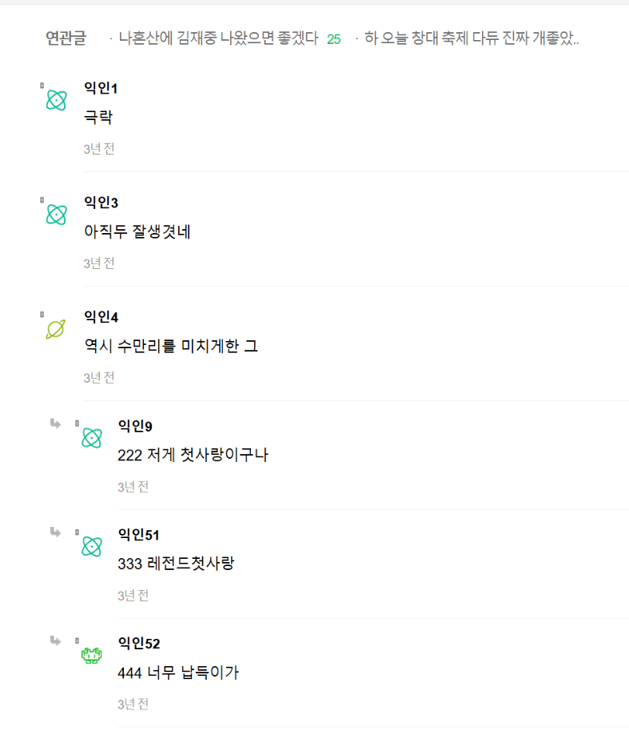
Finding Text
Notes:
Comparison of pannchoa vs instiz, a lot of extra/missing comments so parsing was necessary and could not be automated with ai (we had to do it manually T_T)

Slide 16
What didn’t go well
Cleaning/Alignment
Olifant learning curve
Lots of repeating emoticons/abbreviations
Inconsistent spacing in docs made our text very unaligned on Youalign even with Python scripts
Manually aligned on Trados (extremely time-consuming)

Slide 17
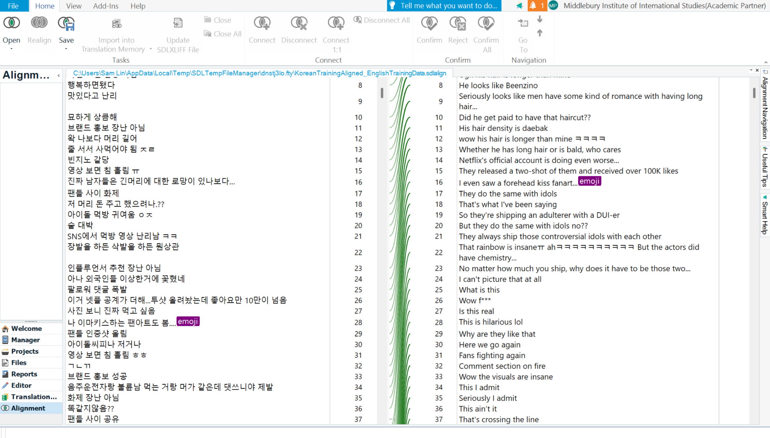
Data Aligning

Slide 18
What didn’t go well
Time Management
Because of the time limit and unexpected setbacks with collection/alignment we had, we could only complete 6 rounds instead of the initial 8 that we wanted to
Already super difficult content to translate, so definitely needed a lot more post-editing rounds to show the improvement we wanted.

Slide 19
What can we improve on in the future?
Time Management
Tool Mastery
Data Collection Practices
Use tools like Jira to manage each person’s roles and milestones in the project for better organization
Olifant and Azure required a learning curve → practice makes perfect!
Input into an XLS file to make sure everything is aligned from the get-go

Slide 20
Did we meet our goals?
Parameter | Goal | Result
Quality | Meaning fully preserved Informal tone/register accurate Cultural & fandom terms clear Light to moderate post editing required | Meaning mostly preserved Informal tone/register sometimes accurate Cultural & fandom terms clear Moderate to heavy post editing required
Timing | 20-30% faster than full HT | ~20% faster than full HT
Pricing | PEMT 20-30% savings over HT | ~40% savings over HT
Notes:
It was only about 30% faster than full HT because there are sometimes typos in comments, abbreviations and slang whose meaning changes overtime.
Timing: Machine Translation actual cost is a little over double than the initial estimated cost

Slide 21
In conclusion:
While some goals were met, without further training we do NOT recommend this project as an MT engine

Slide 22
Thank you!
Please keep this slide for attribution

